Slide 1
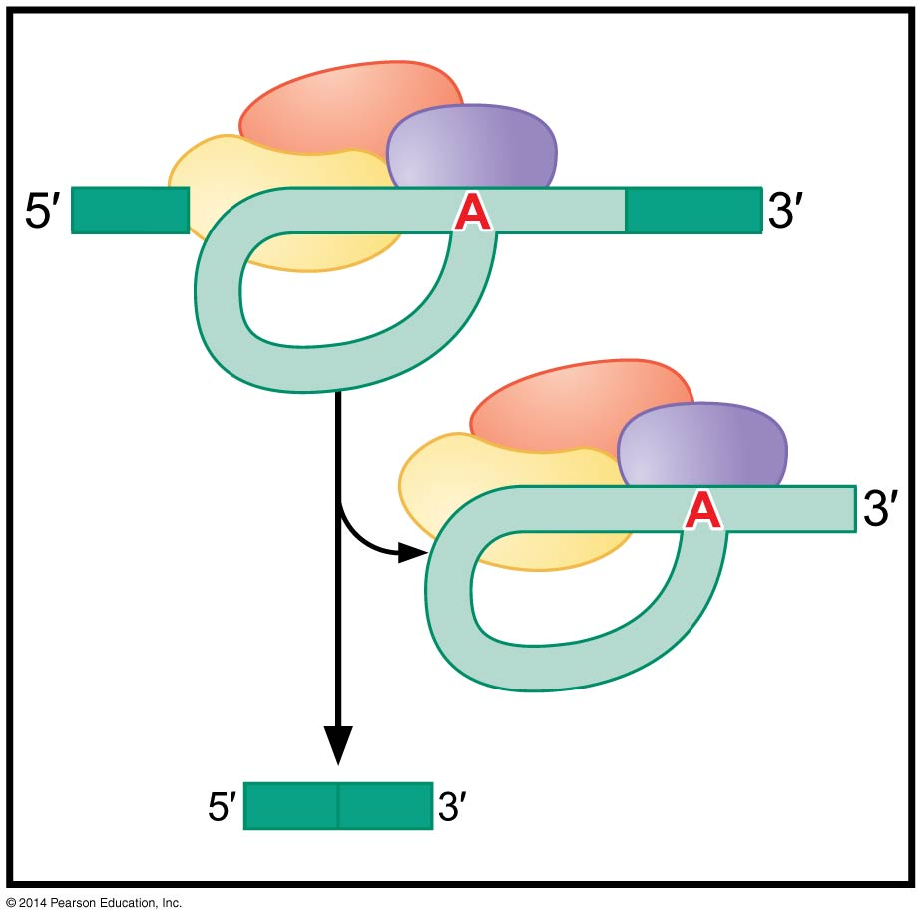
RNA splicing: historical perspective & overview
BT 454
Chapter 14

Slide 2
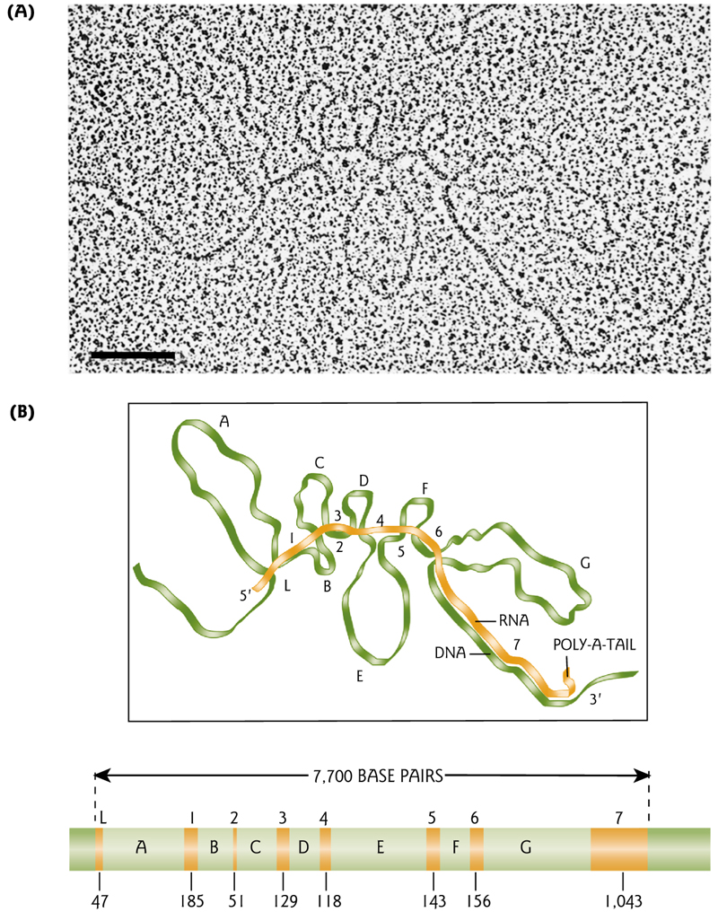
Discovery of “Split genes”
The central dogma & principle of “colinearity” proved wrong by Philip Sharp in 1977 while studying Eukaryotic transcription using adenovirus
Further proved by albumin gene studies
Other genes are split genes

Slide 3
What is intron?
1978
  introns are intervening sequence
  “junk DNA”
1990
  Some introns contains regulatory elements (enhancers, silencers)
  Introns coding for small RNA (snoRNA, microRNA)
1994
  “Inside-out” genes
Now
  Introns are sequences that remain separated after excision and exons are sequences that are ligated together after excision

Slide 4
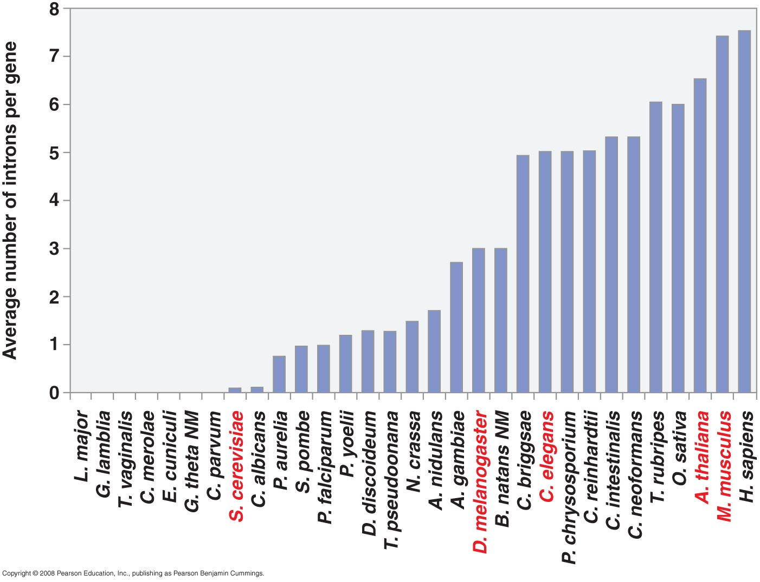
Number of intons per gene in eukaryotic species

Slide 5
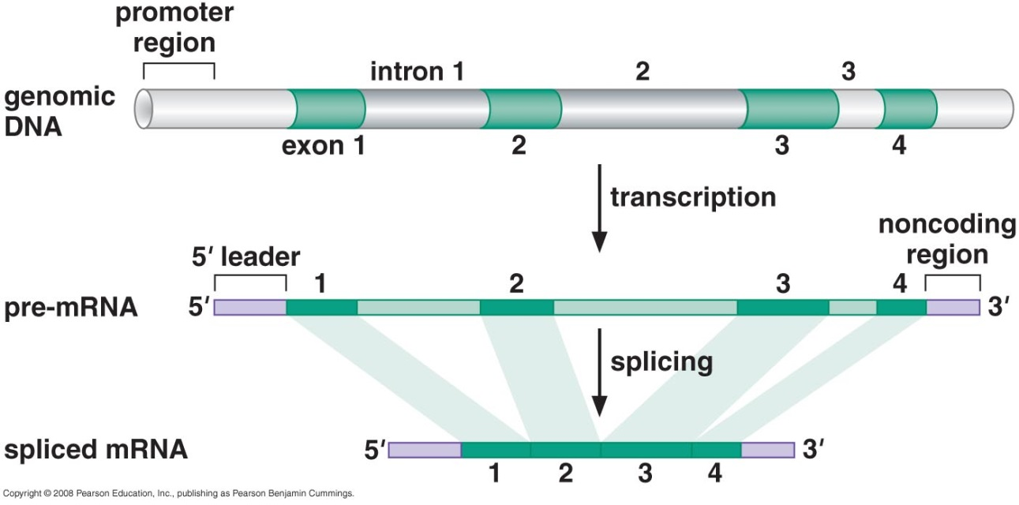
RNA splicing
Exons ~ 150 nucleotide
Introns ~ 3000 - 80.000 nucleotide
Alternative splicing
Trans-splicing

Slide 6
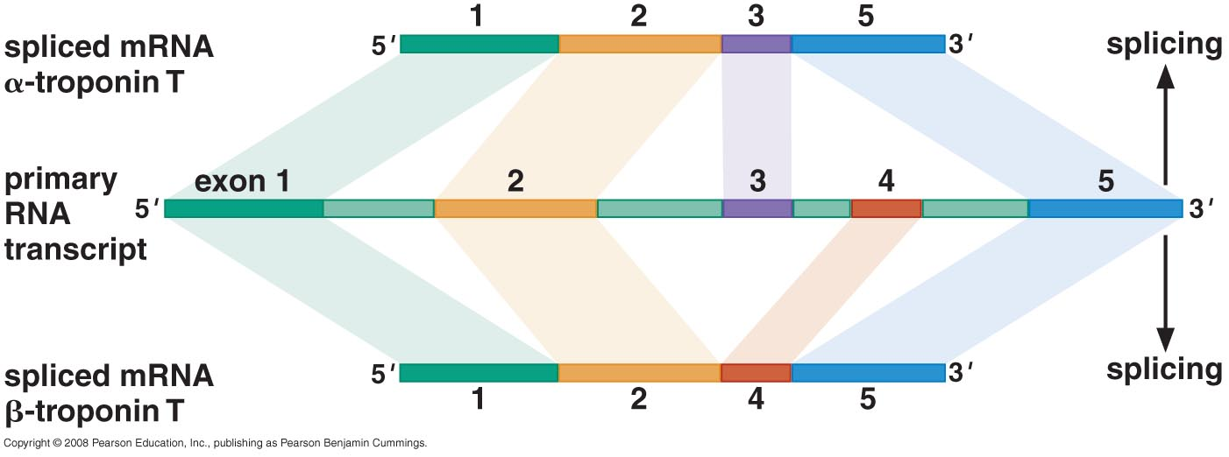
Alternative splicing
60% of genes spliced in alternative way
Alternative products called isoforms
Drosophila gene encodes 38.000 possible product!

Slide 7
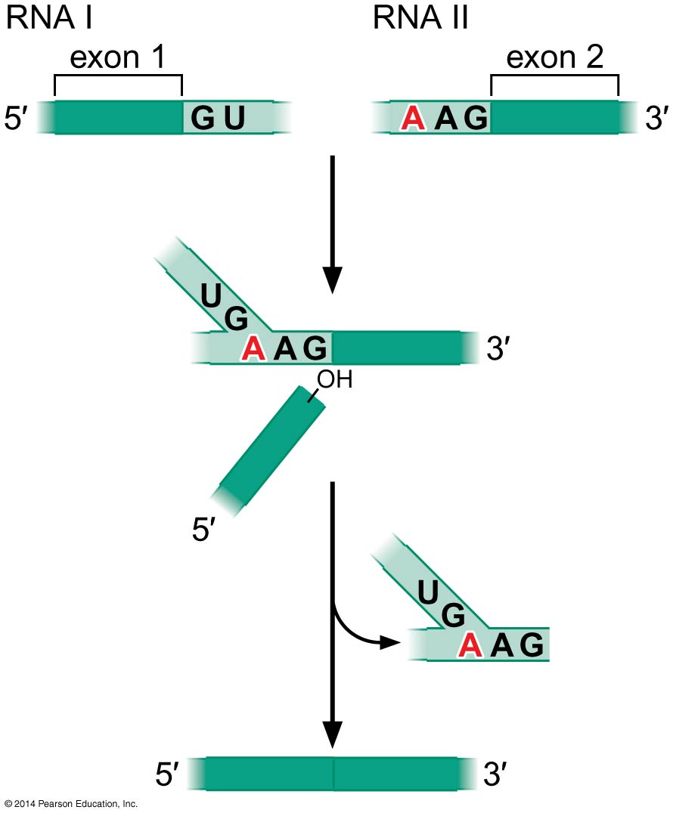
Trans-splicing
Exons from different mRNA molecules are spliced together.
Not cis-splicing
Rare
Not reported in mammals
Notes:
Exons from different mRNA molecules are spliced together

Slide 8
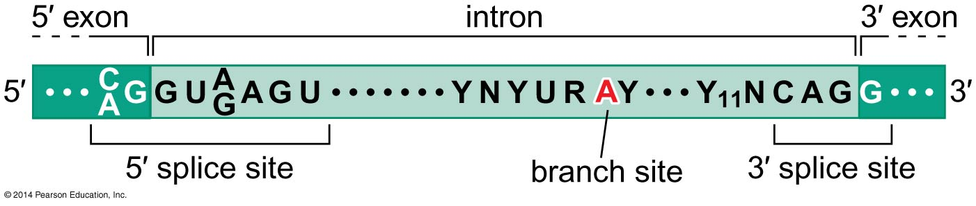
Where should splicing occur?
High precision is essential to prevent frame shift

Slide 9
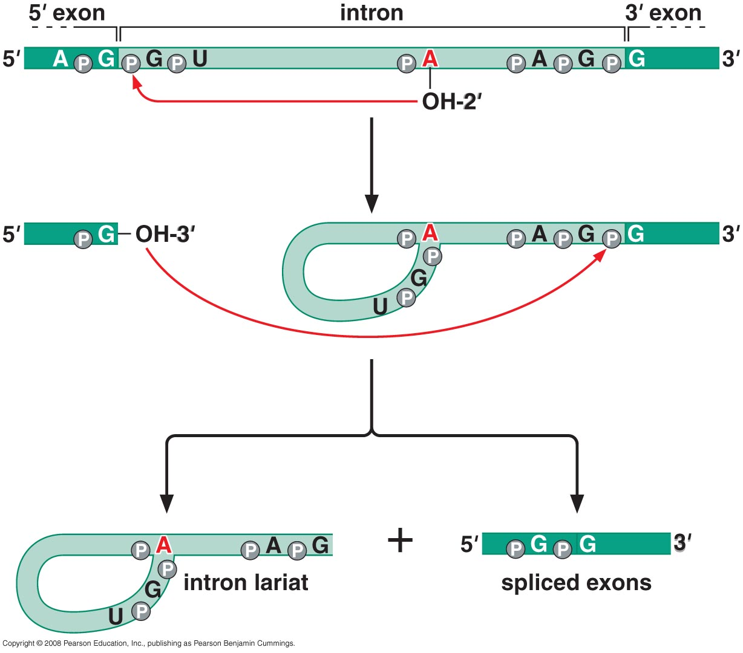
Splicing reaction

Slide 10
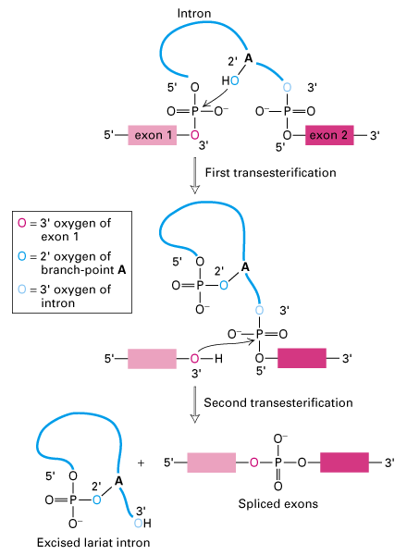
Splicing reaction
It goes only forward
  Forward reaction involved increase in entropy (2 product molecule Vs 1 substrate)
  Lariat is degraded can’t be recalled

Slide 11
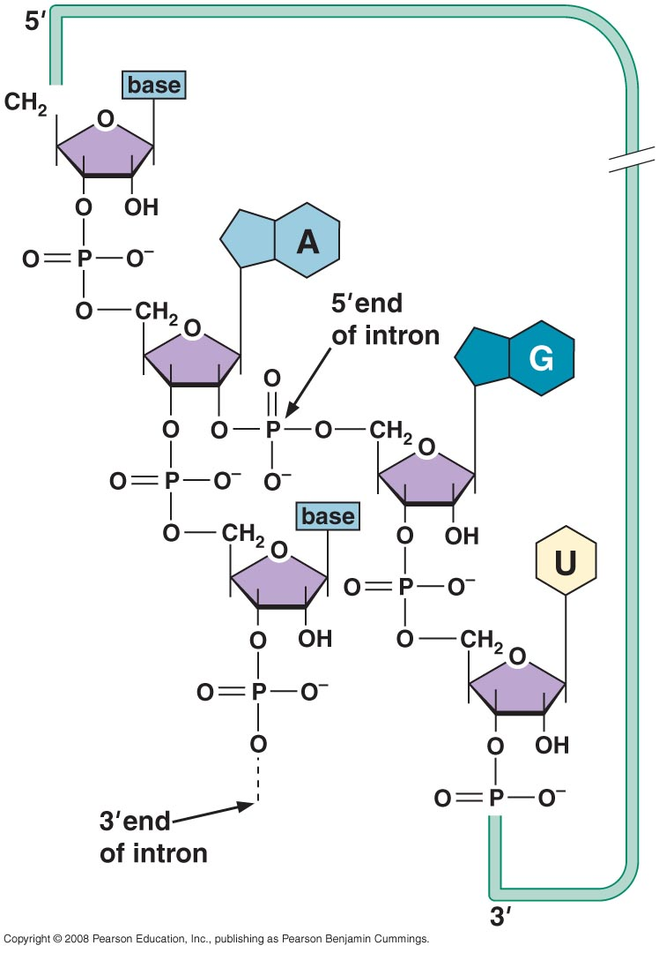
Three way junction at branch point site
Notes:
Forming a lariate

Slide 12
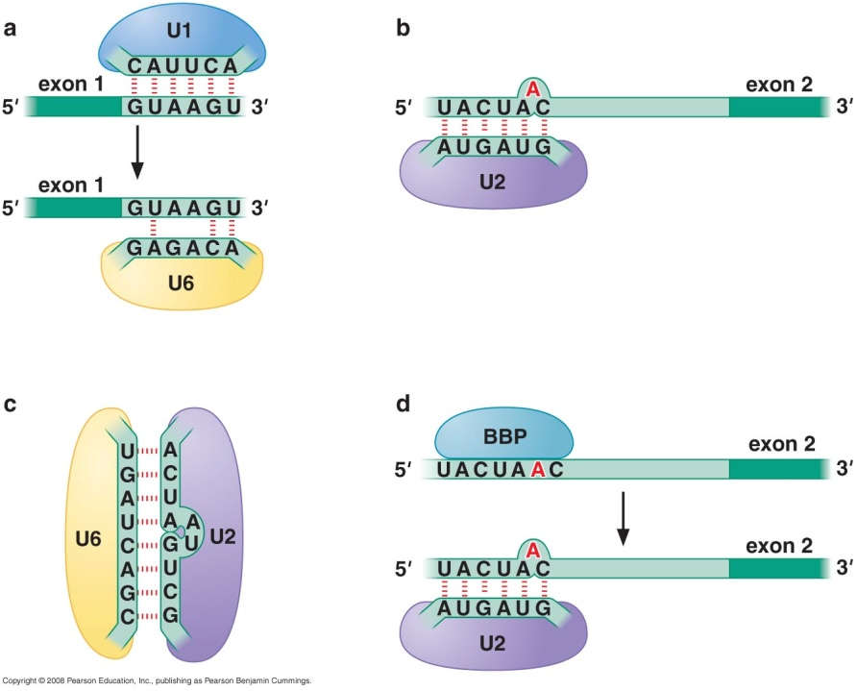
Spliceosome machinery
Huge molecular machine
  5 small nuclear RNA (snRNAs)
  Proteins complexed with snRNA (snRNPs)
  Non-snRNP proteins
    U2AF (U2 auxillary factor)
    Branch point binding protein (BBP)
    RNA annealing factor
    DEAD-box helicase
Needs ATP
Notes:
RNA 100-300 nucleotide long
RNA recognize sequence

Slide 13
snRNPs function
Recognize 5`splice site & branch site
Bring those sites together
Catalyze RNA cleavage
This involves:
  RNA-RNA interaction
  RNA-Protein interaction
  Protein – protein interaction

Slide 14
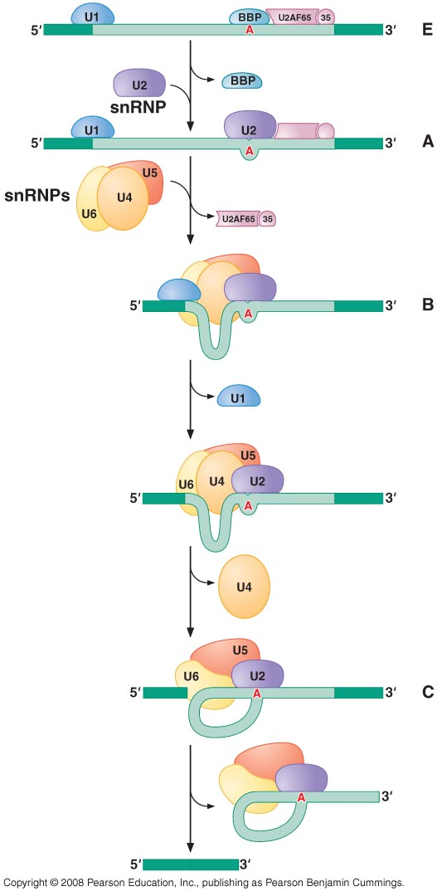
Splicing pathway
E complex
Notes:
U1 at 5` splice site + branch point binding protein (BBP) at branch point + U2AF at polypyramidine tract + 35 subunit next at 3` splice site = Early (E) complex
U4 is held together with U6 by RNA complementary interactions while U5 is loosely bounded through protein – protein interaction

Slide 15
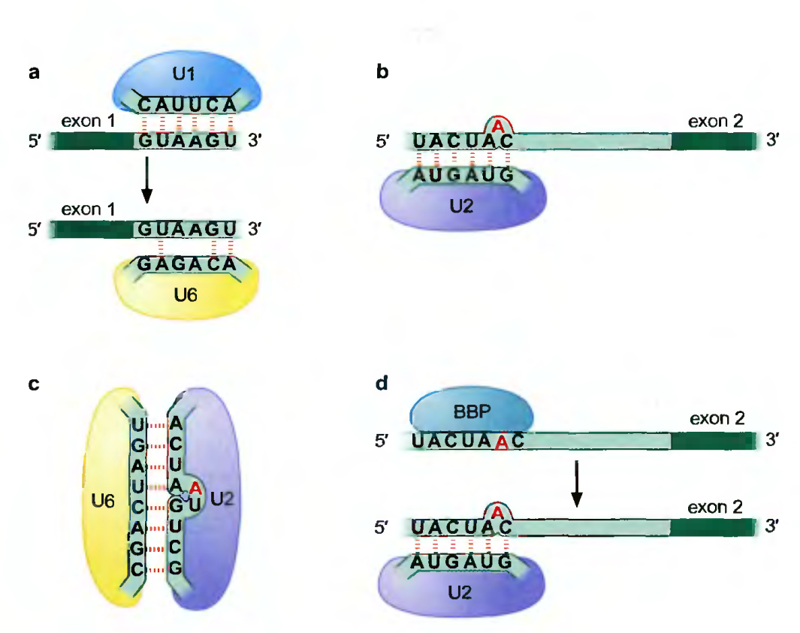
Splicing pathway
E complex
A complex
Notes:
U1 at 5` splice site + branch point binding protein (BBP) at branch point + U2AF at polypyramidine tract + 35 subunit next at 3` splice site = Early (E) complex
U4 is held together with U6 by RNA complementary interactions while U5 is loosely bounded through protein – protein interaction

Slide 16
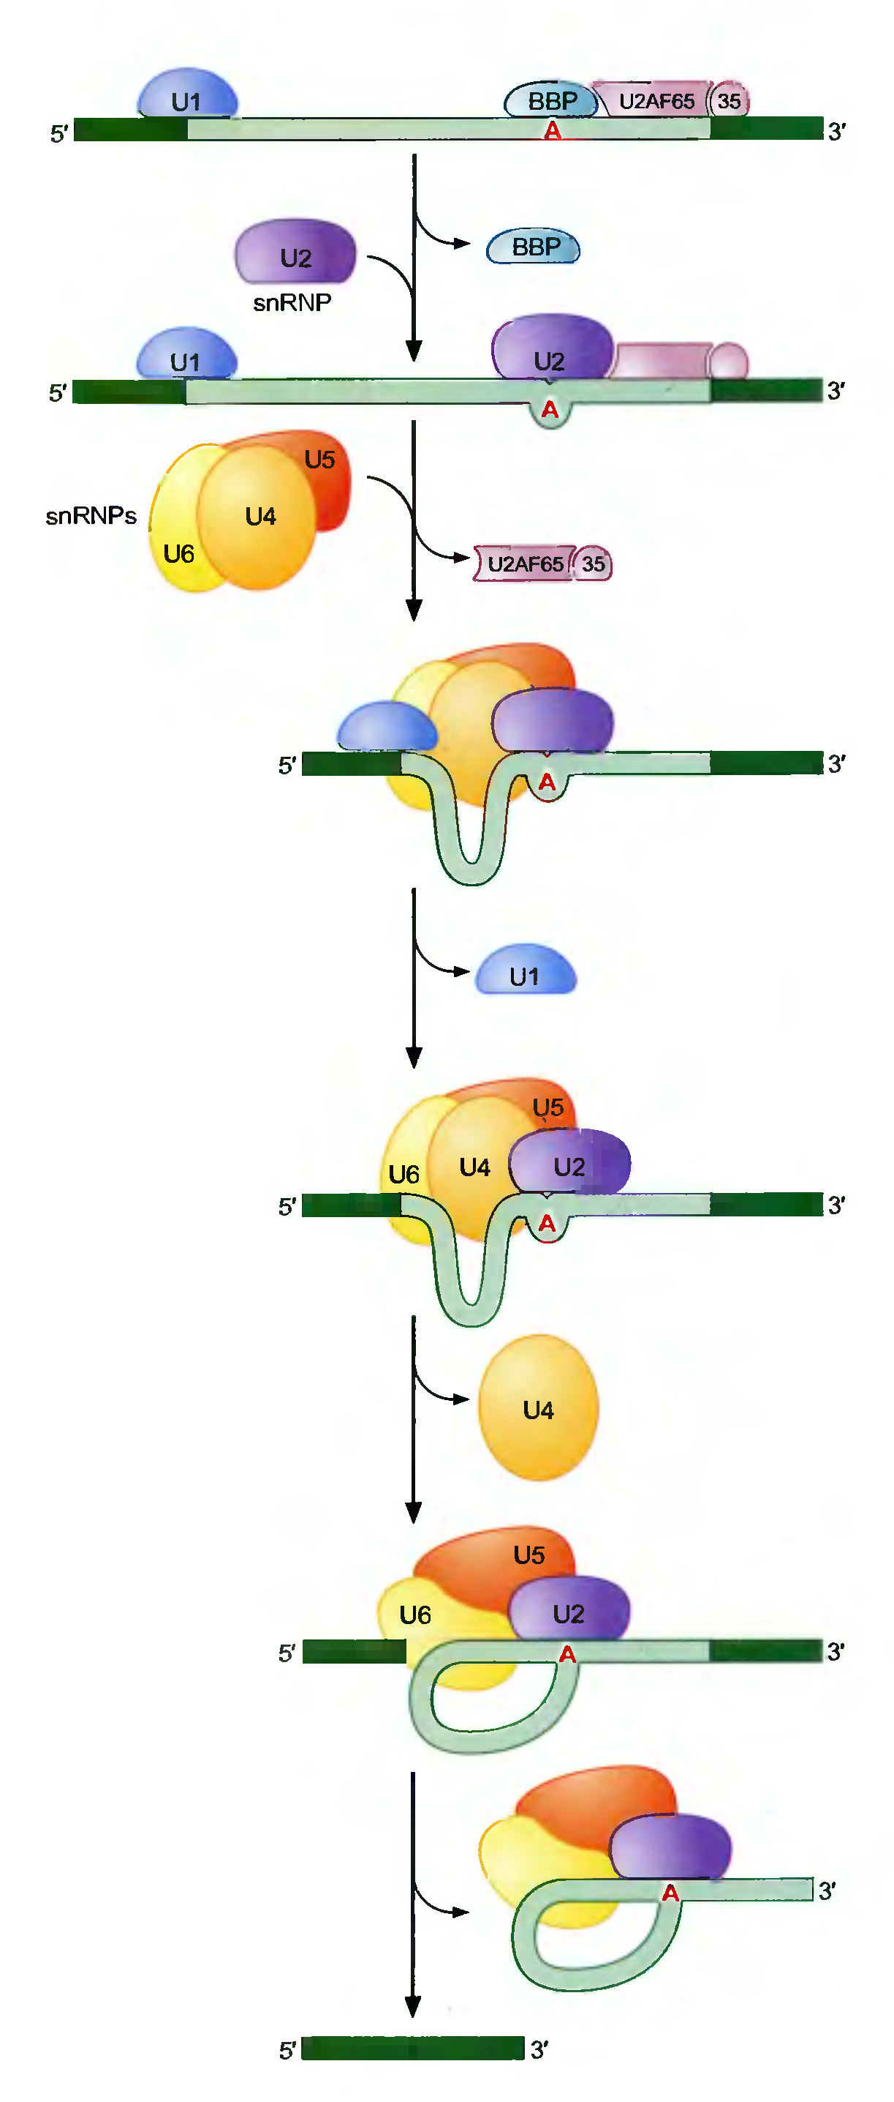

Splicing pathway
E complex
A complex
B complex
  Tri-snRNP particle
  Bring together 3 splice site
Notes:
U1 at 5` splice site + branch point binding protein (BBP) at branch point + U2AF at polypyramidine tract + 35 subunit next at 3` splice site = Early (E) complex
U4 is held together with U6 by RNA complementary interactions while U5 is loosely bounded through protein – protein interaction

Slide 17
Splicing pathway
U6 replaces U1

Slide 18
Splicing pathway
U6 replaces U1
C complex
  U4 released to allow U6 : U2 interaction
  1st transesterification reaction
U5 facilitate 2nd trans-reaction

Slide 19
Splicing pathway

Slide 20
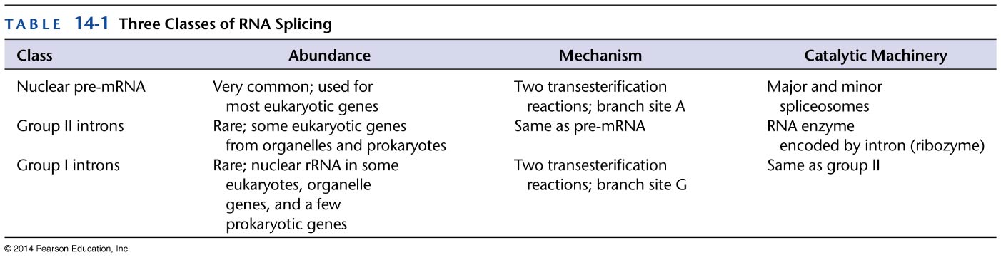
Classes of introns
Nuclear pre-mRNA
Self splicing
  Group I
  Group II

Slide 21
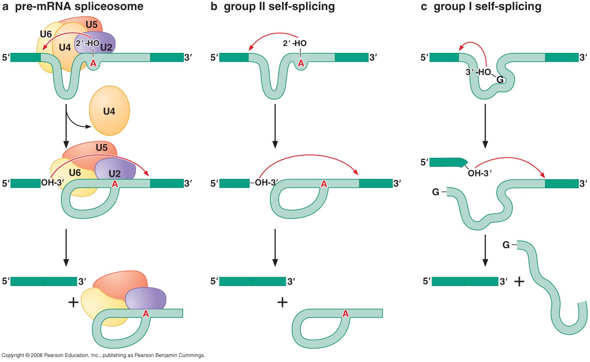
Classes of introns

Slide 22
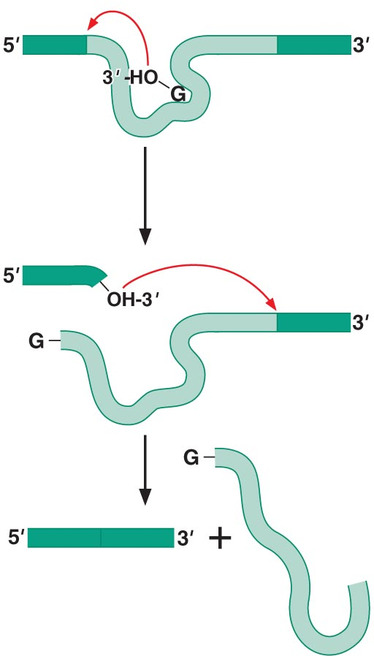
Group I introns
Use free G nucleotide/side
Conserved sequence → conserved 2ry structure
Proteins to allow precise folding
Most important conserved areas:
  Nucleotide binding pocket
  Internal guide sequence

Slide 23
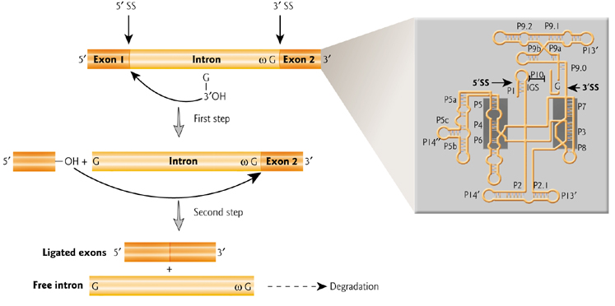
Group I introns

Slide 24
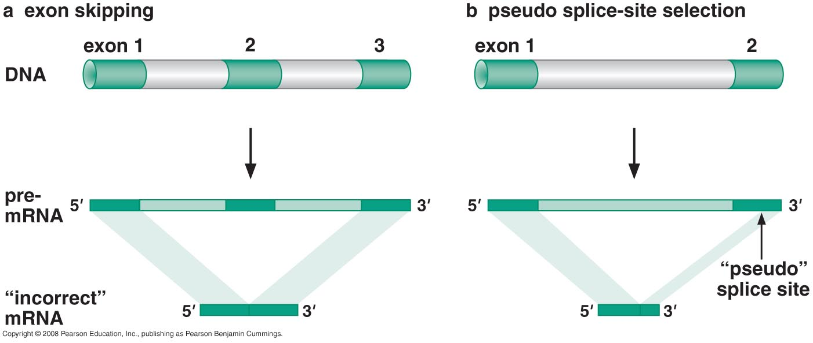
Errors in splice site selection
Splicing sites are loose consensus sequences
Drosophila gene has 363 exon and can divide into 38.000 way
Exons ~ 150bp while introns ~ 3000 bp
Notes:
Loose consensuse sequences allow for pseudo spice site

Slide 25
Finding the splice site
Multiple proteins interact with a splice site (U1, U6)
Splicing machinery locate splice sites as soon as the RNA is transcribed
Proteins bounded to exons to be differentiated from similar sequences in introns

Slide 26
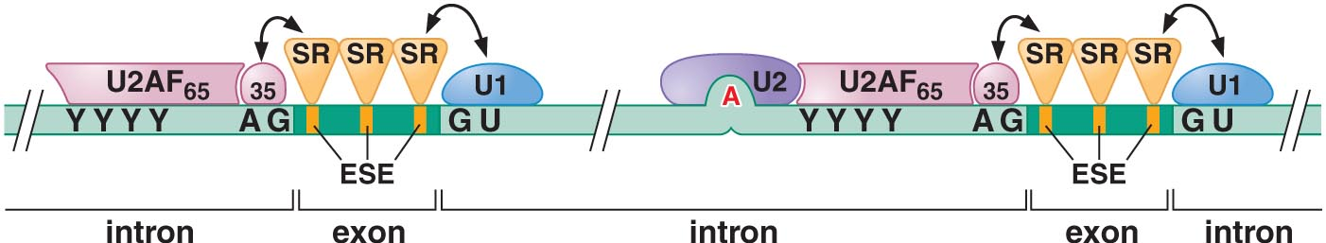
Finding the splice site
Serine Argenine rich proteins (SR) binds to exonic splicing enhancers (ESEs)
Ensure accuracy of splicing
  Recruit U2AF to 3` site
  Recruit U1 to 5` site
Regulate alternative splicing
  Expressed upon physiological signals
  Expressed Constitutively
  Expressed in certain cells

Slide 27
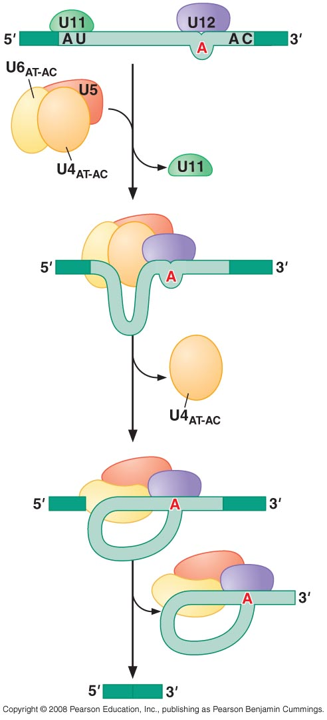
U12-intron splicing pathway
U12 (minor splicosome) present in 0.15-0.34%
U11, U12, U4atac, U6atac analogous to U1, U2, U4 & U6 but recognize different sequences
U5 is common
Notes:
Penta-sNRP model is based on invivo studies where the whole 5 snRNPs plus other proteins were isolated as one piece
While stepwise model is supported by chromatine immunopreciptation ChIP which detected a stepwise construction of the complex also the step wise serves the function of double checking of sequences and folding the mRNA appropriately

Slide 28
Alternative Splicing

Slide 29
Alternative splicing
Occurs in 40% of Drosophila gene
Occurs in 75% of human genes
Most alternative splicing generate 2 isoforms
Extremes get to hundreds in human (Slo gene) or thousands in Drosophila (Dcam gene)

Slide 30
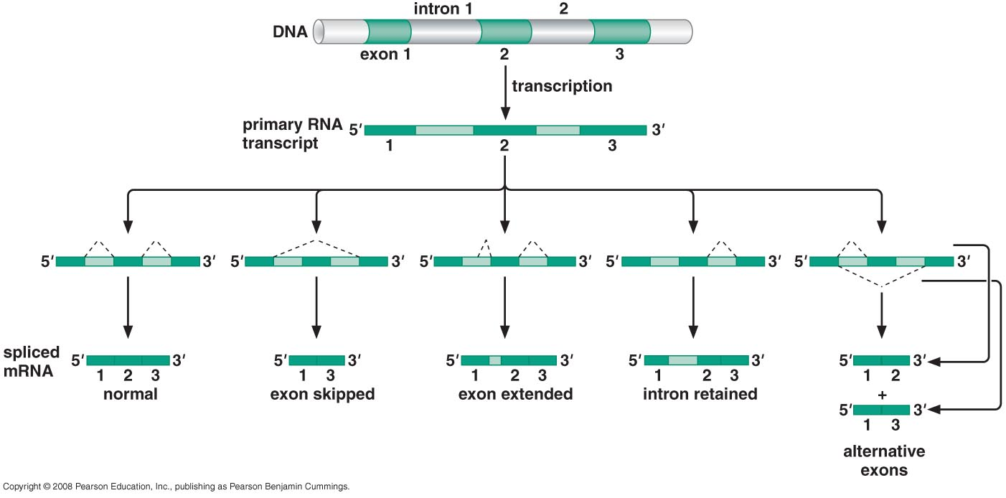
Alternative splicing
Alternative splicing can result from using different promoters

Slide 31
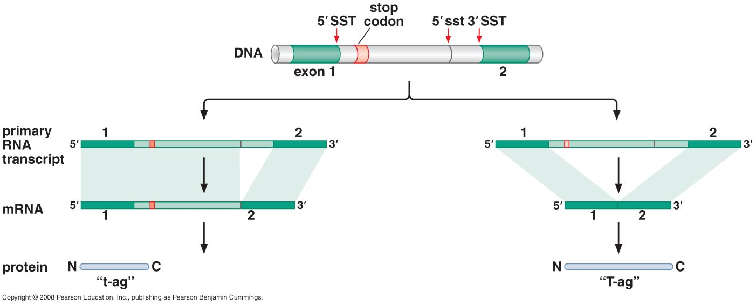
Constitutive splicing
SV40 DNA virus
Constitutively produce two isoforms of antigens
  T antigen : induce transformation & cell cycle
  t antigen : block apoptotic response
Level of SF2/ASF (SR proteins) splicing protein determine antigen produced
Notes:
SV40 DNA virus was identified in cultures of rhesus monkey kidney cells that were used to produce polio vaccine and was found Related to cancer in both humans and monkeys
SF2/ASF are SR proteins
High SF2/ASF level favors the use of splice site nearer to exon 2 therefore which is the 5`sst and in this case the t antigen is produced

Slide 32
Cassette exons
Pair of exons if one is included the other is excluded
Mutual exclusive splicing
Most common form of alternative splicing

Slide 33
Mechanism for mutual exclusive splicing
Steric Hindrance
Combination of major and minor splice sites
Nonsense mediated decay

Slide 34
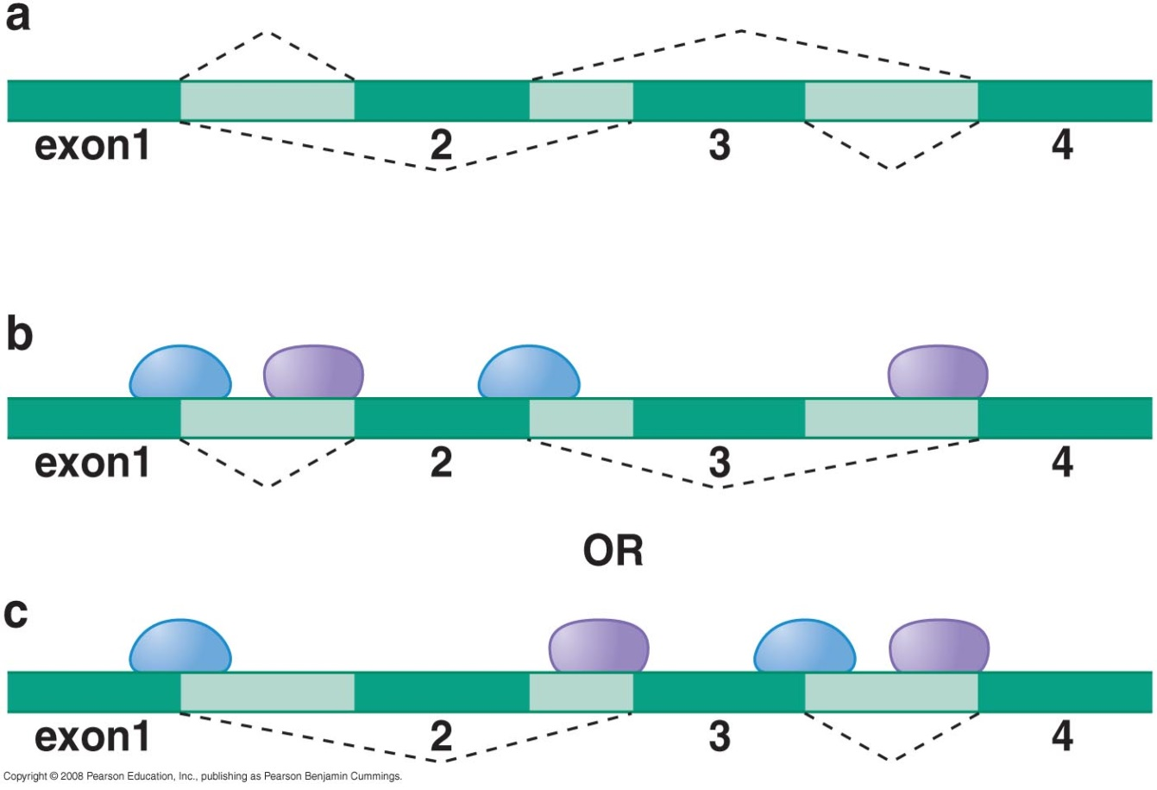
Mechanism for mutual exclusive splicing
1- Steric Hindrance
Splice site too close to each other
Exons < 59 nucleotide

Slide 35
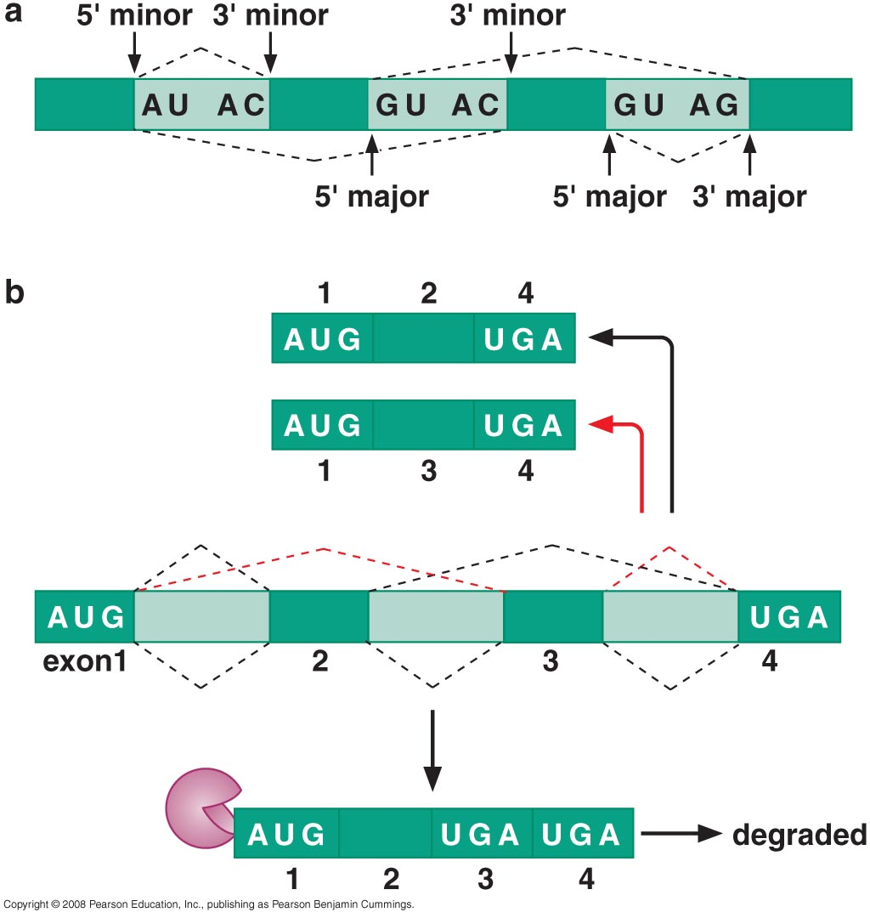
Mechanism for mutual exclusive splicing
2- Combination of major & minor SS
No combination of major & minor sites is allowed
What might happen if combination takes place?

Slide 36

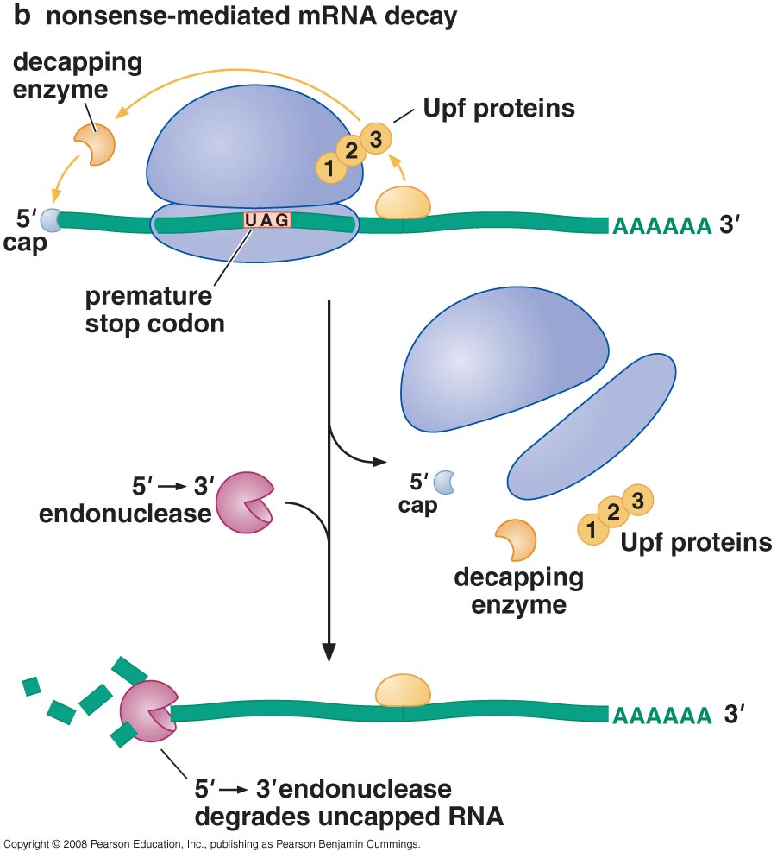
Mechanism for mutual exclusive splicing
3- Nonsense medicated decay
Including two exons produce mRNA that contains premature termination codon

Slide 37
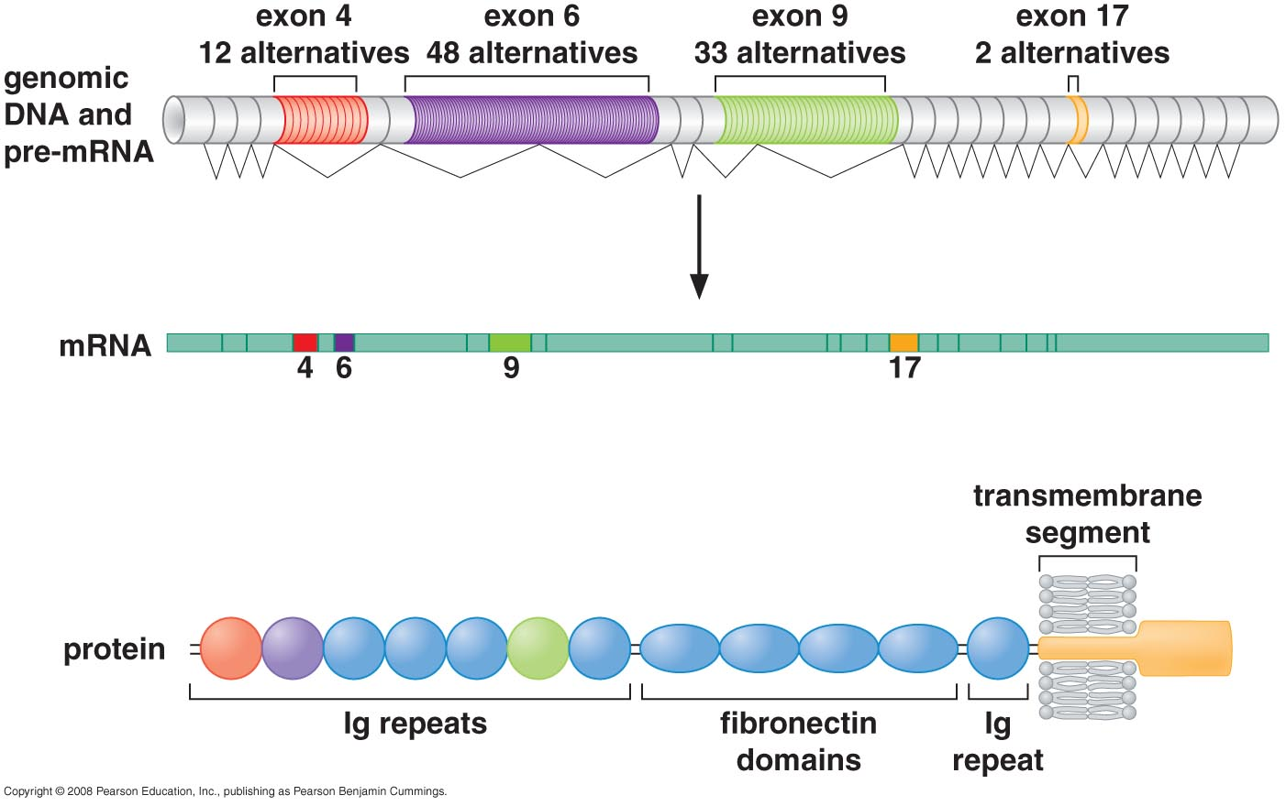
Drosophila Dscam Gene Splicing
How does it happen?
mRNA is made of 24 gene exon
  20 consistent
  4 with multiple alternatives
No one of the suggested mechanism of mutually exclusive splicing mechanism could explain it

Slide 38
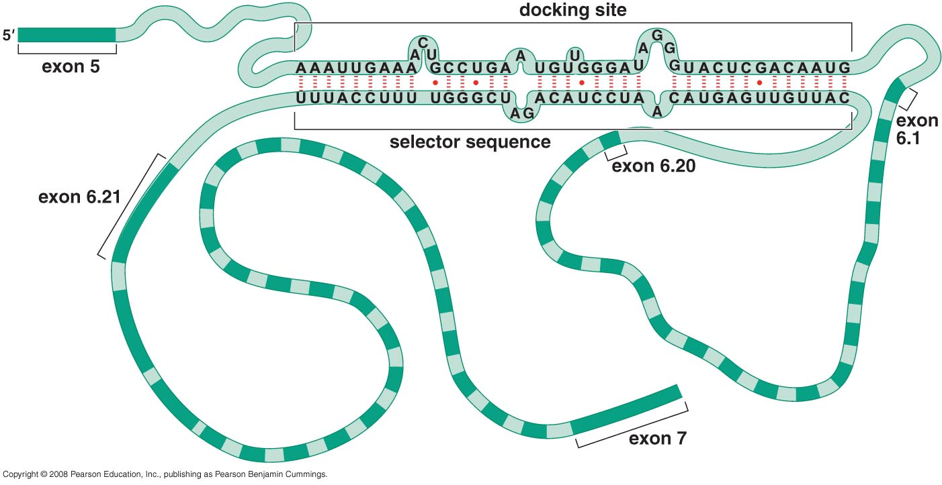
Drosophila Dscam Gene Splicing
How does it happen?

Slide 39
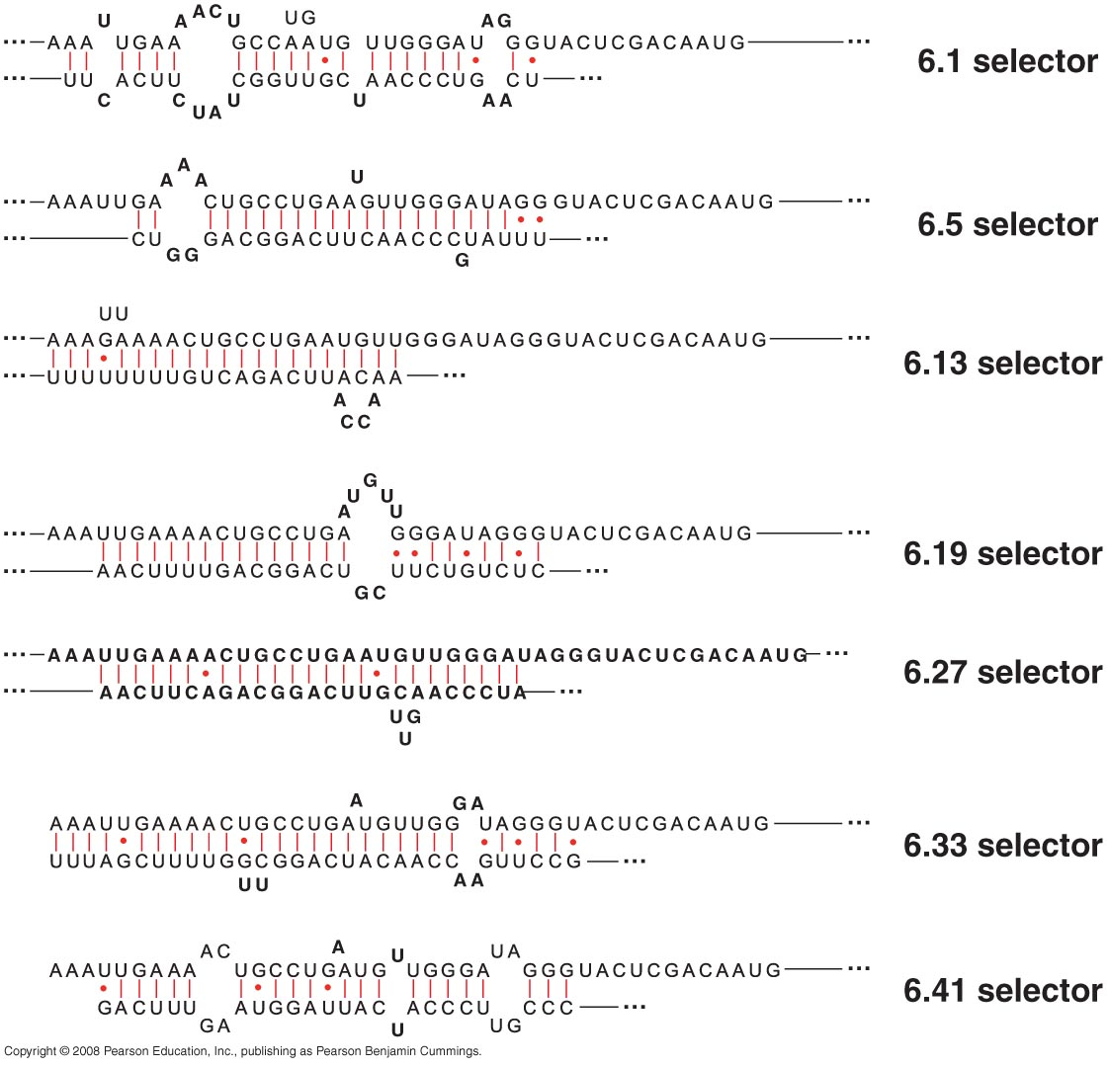
Selector sequences for six exon 6 variants

Slide 40
Drosophila Dscam Gene splicing
How does it happen?
Binding of selector sequence to docking site:
  Bring chosen exon variant close to previous exon
  Protect chosen exon variant from general repression (Hrp36)
    RNA 2ry structure
      Prevent binding of repressor
      Provide binding site for activators
    Become close to activators in in the previous exon

Slide 41
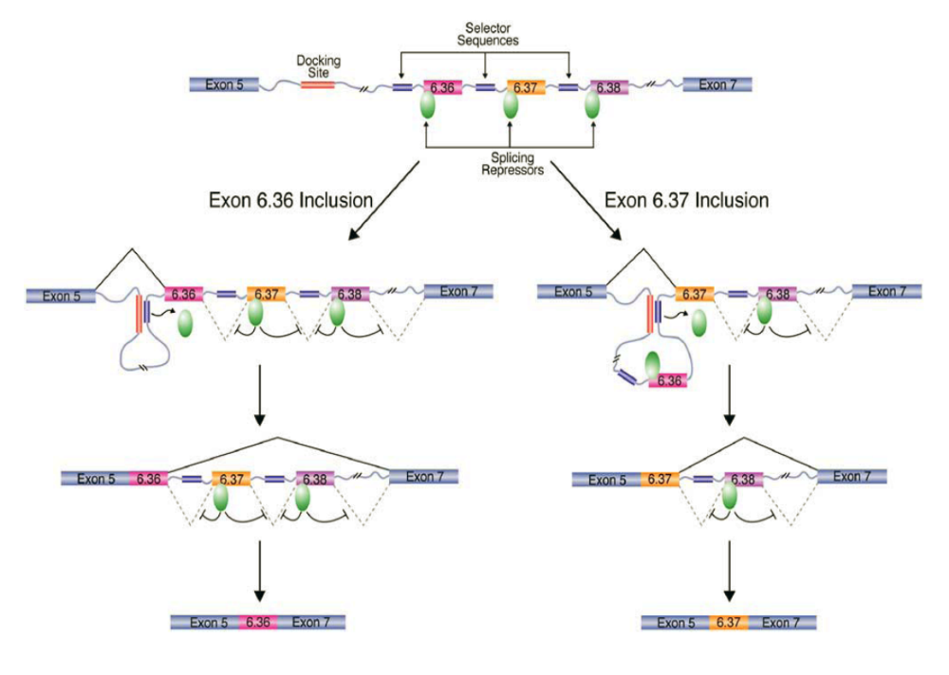

Slide 42
Why all these alternatives are needed for Dscam Gene?
Cell surface protein of Ig superfamily
Two different functions:
Neural patterning in the brain
  Mediate specific cell-cell interaction (only similar isoforms interact)
Recognize Ag

Slide 43
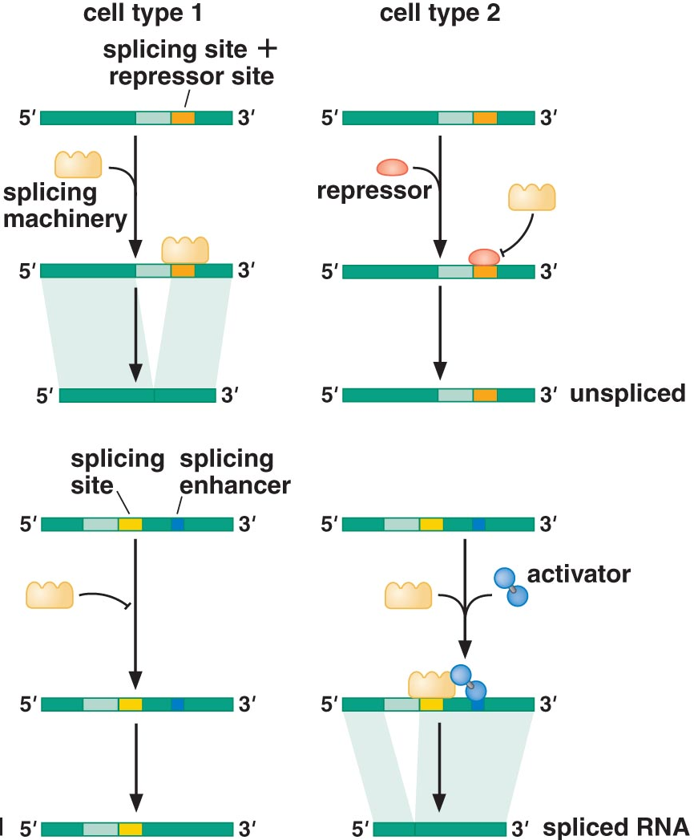
Regulated alternative splicing
SR proteins determine which particular splice site is activated
  Particular cell type
  Particular stage of development
SR has two domains
  RNA recognition motif (RRM)
  RS domain, recognize proteins in splicing machinery

Slide 44
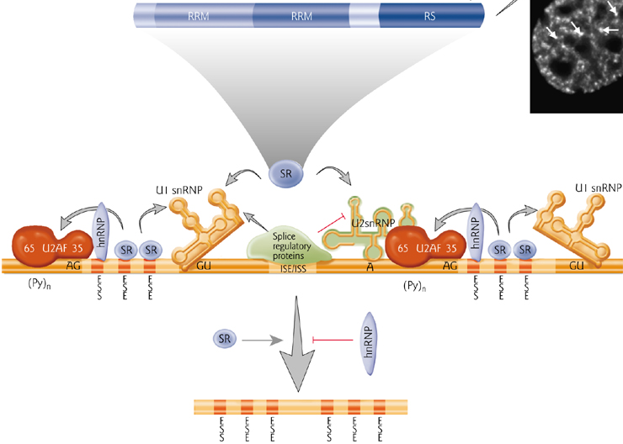
Splicing regulators
SR proteins bind to exon splice enhancers (ESE) & recruit splicosomes
hnRNP binds to exon splice silencers (ESS) but lack RS domain
Examples:
  hnRNPA1 is silencer (prevent SC35 binding but not SF2/ASF)
  hnRNPI
Notes:
hnRNP they have the RNA recognition sequence but lack the RS domain so they can’t interact with the splicing machinery and hence do not recruit them and caused silencing
It is an interactive process, where stronger ESE overcome the action of weak ESS and also binding of two or more SR to enhancer can overcome the action of a single hnRNP protein

Slide 45
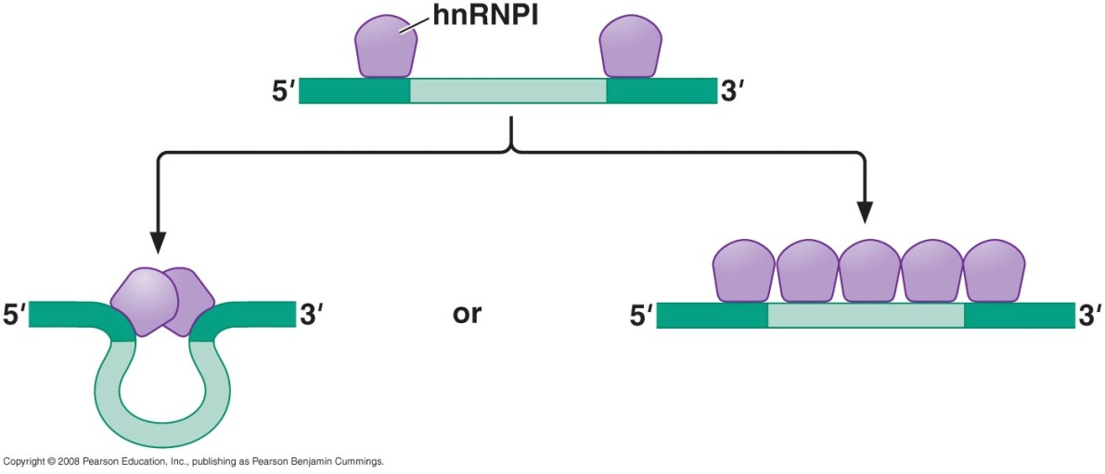
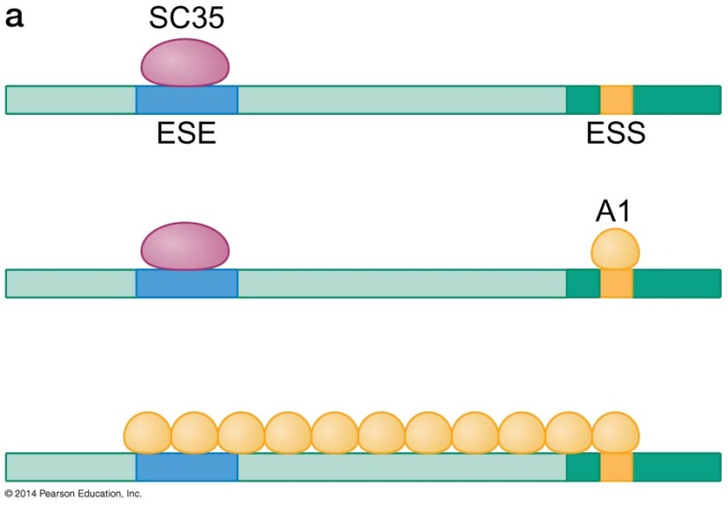
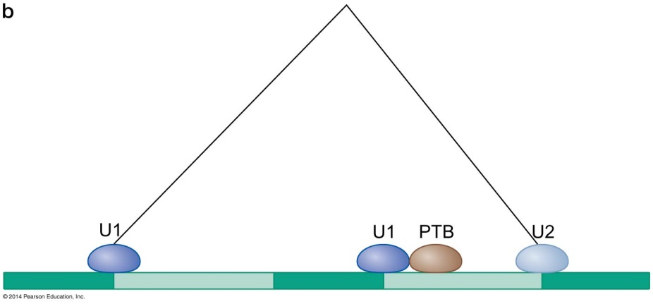
Inhibition of splicing by hnRNPI
Polypyrimidine tract binding protein
Action:
Prevent binding of splicing machinery to Py tract
Exclude the exon
  Looping out the exon
  Covering exon totally

Slide 46
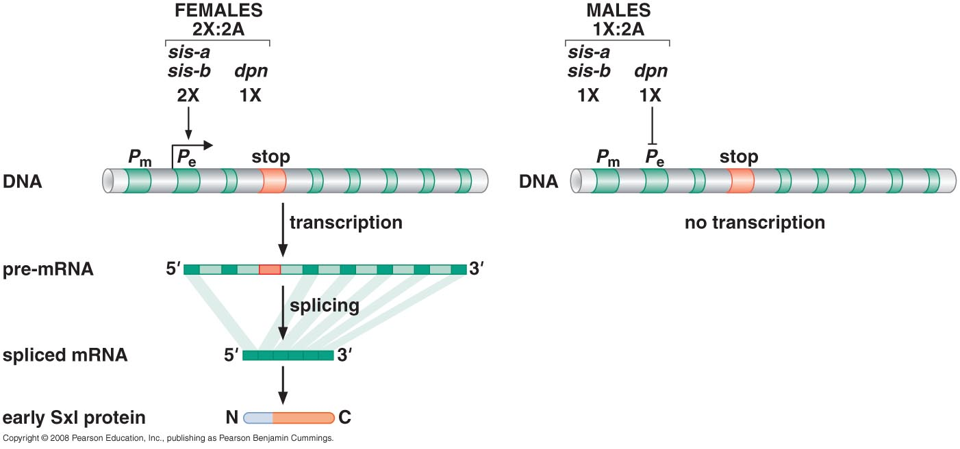
Example of alternative splicing determination of the sex of the fly
No Y chromosome to determine maleness so ratio of X chromosome used to determine female characteristics
  Sis a, b activators
  Dpn repressor
  Both binds to sex lethal gene (Sxl)
Notes:
Sis A and B genes are present on the X chromosome, so the amounts of sis a and sis-b proteins is twice that produced by male fly because it has one X, Deadpan gene is present in chromosome 2 so it is expressed equally in male and female
Abandant amount of sis-a,b can turn the gene on

Slide 47
Example of alternative splicing determination of the sex of the fly
Two promoters in Sxl gene
  Pe = promoter of establishment
  Pm = promoter of maintenance
In Pm extra exon is present which should be spliced out to get a functional Sxl protein
In females Sxl protein should be always present
Notes:
Sis A and B genes are present on the X chromosome, so the amounts of sis a and sis-b proteins is twice that produced by male fly because it has one X, Deadpan gene is present in chromosome 2 so it is expressed equally in male and female
Abandant amount of sis-a,b can turn the gene on

Slide 48
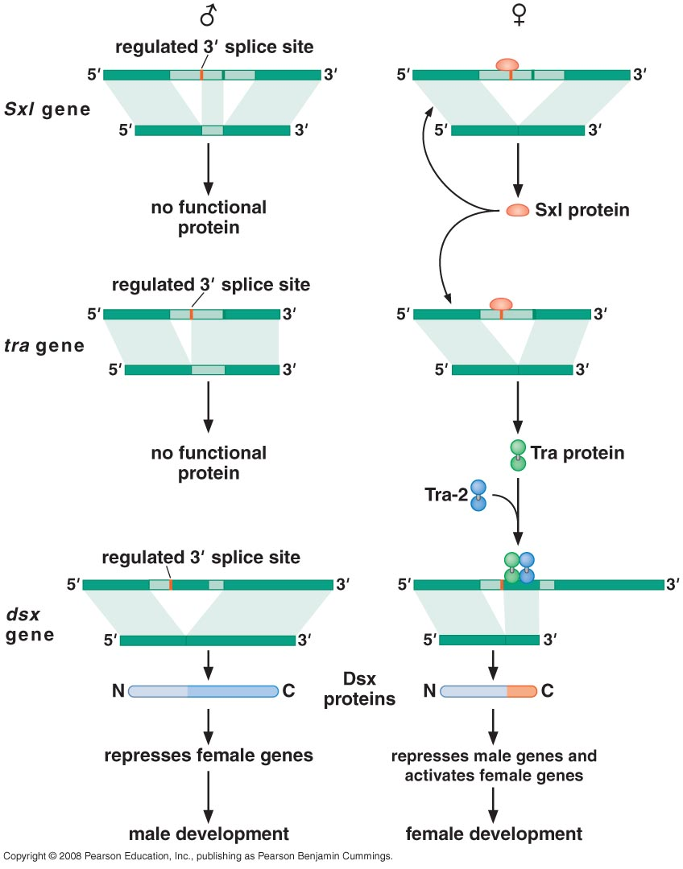
Example of alternative splicing determination of the sex of the fly
Sxl protein produced in females from Pe initially
Sxl gene is auto-regulated by it’s own protein product
Sxl protein act as splicing repressor
Sxl protein also regulate other gene (tra gene)

Slide 49
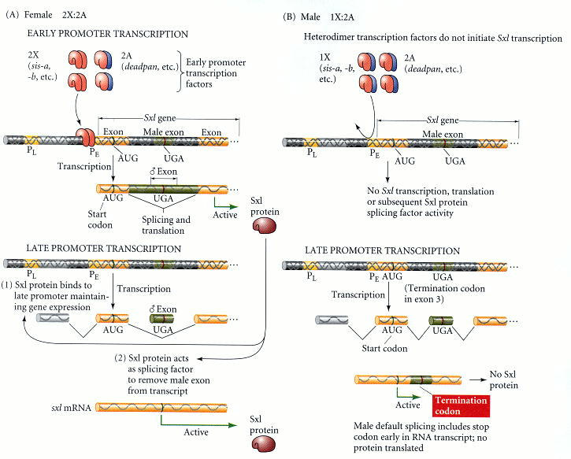

Slide 50
Example of alternative splicing
Sxl protein act as splicing repressor for tra gene
Tra protein is splicing activator for double sex gene (dsx)

Slide 51
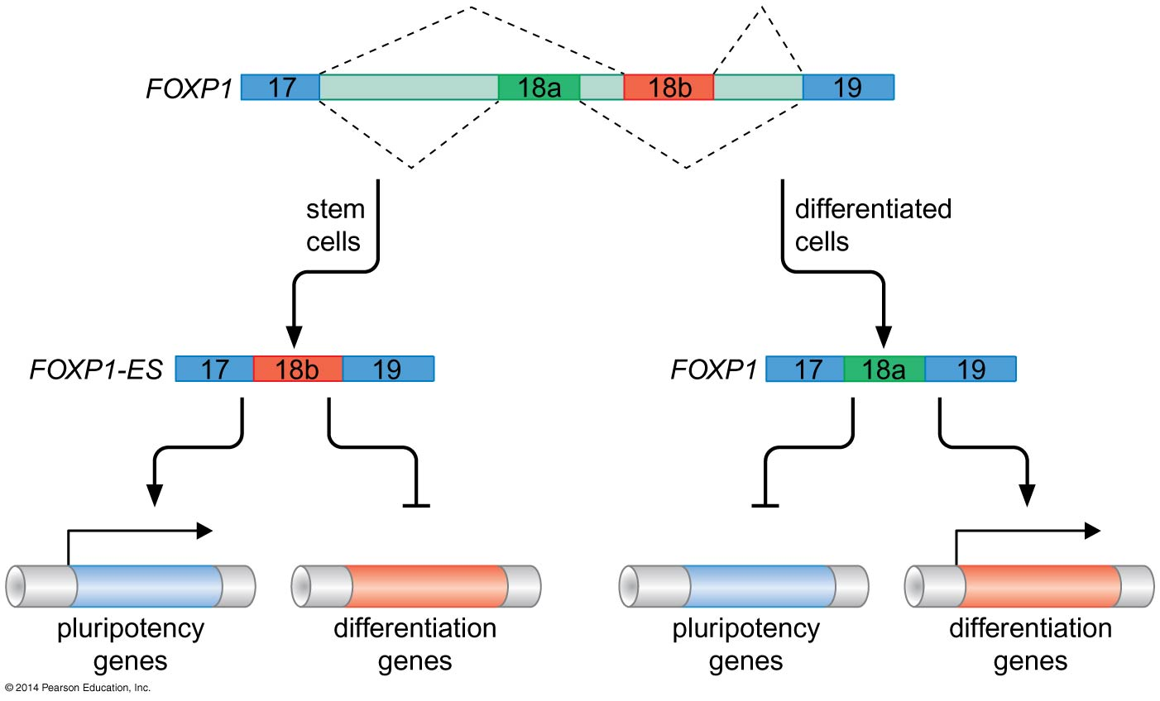
An alternative splicing switch lies at the heart pluripotency.

Slide 52
Exon Shuffling

Slide 53
Introns
Bacteria have minimum introns
Eukaryotes have plenty of introns
  Why did bacteria remove introns (introns early model)
  Why did Eukaryotes develop introns (introns late model)
  Why did Eukaryotes keep introns
    Exon shuffling hypothesis by Walter Gilbert 1977

Slide 54
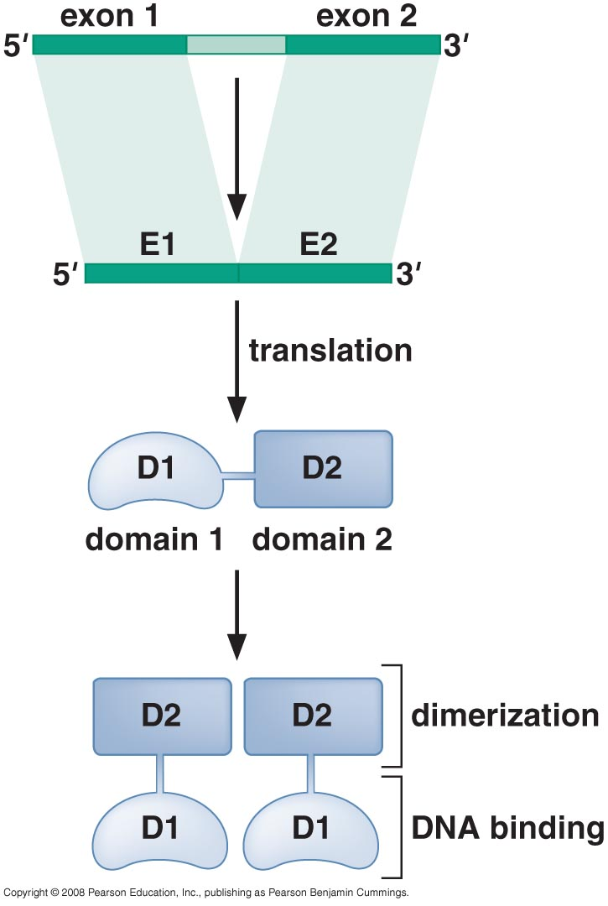
Introns, what for?
Separate between domains (one exon encode for one protein domain)
alternative splicing → huge variety of proteins
Notes:
Duplication and divergence as it occurs in immunoglobulin

Slide 55
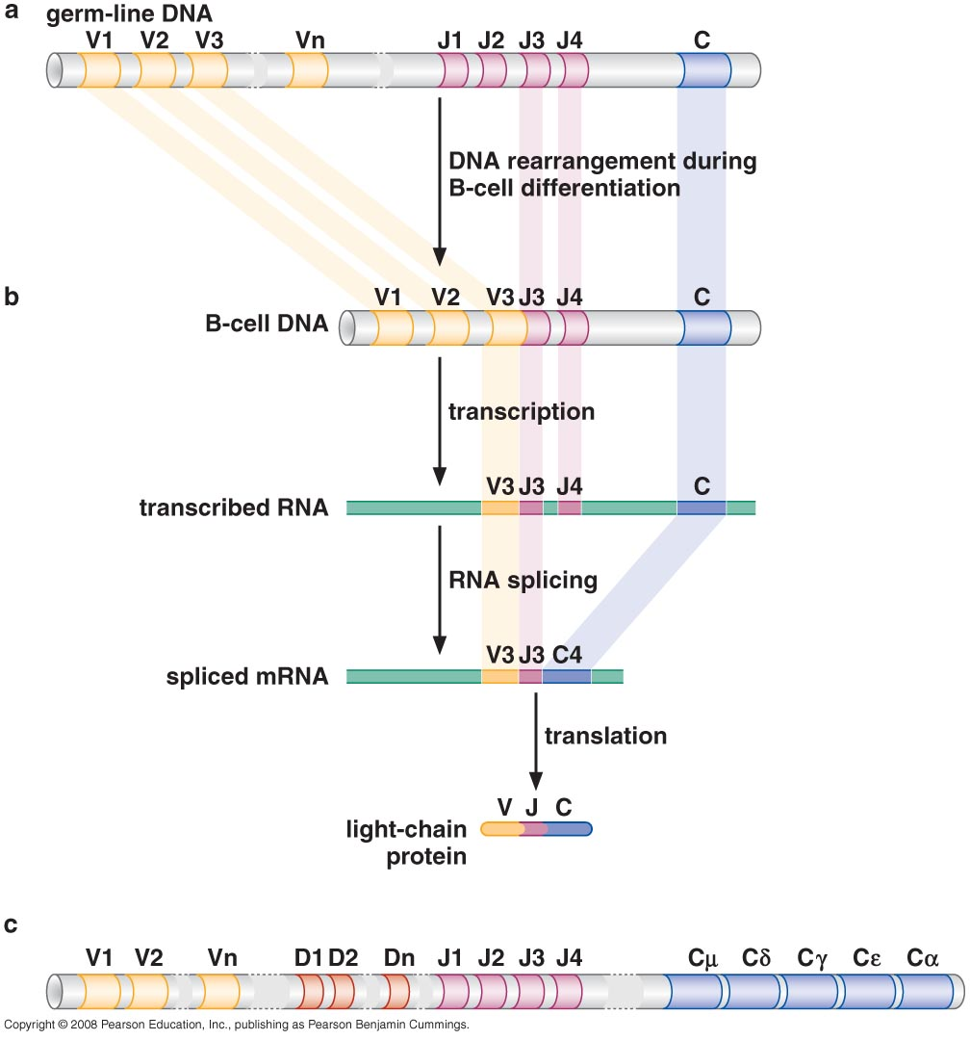
Introns, what for?
exon duplication and divergence
Notes:
Duplication and divergence as it occurs in immunoglobulin

Slide 56
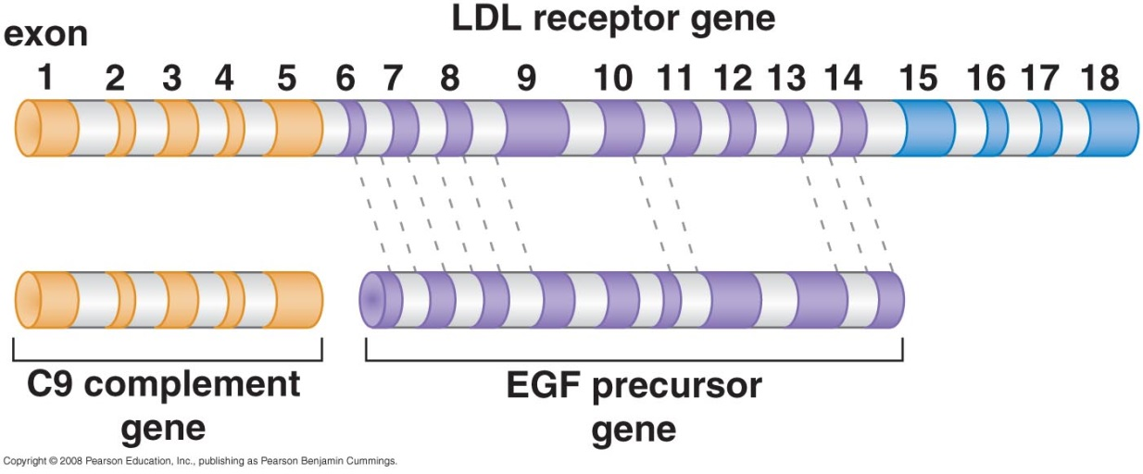
Introns, what for?
Recombination takes place in introns not exons (exons are shuffled not disrupted)
snoRNA genes which are librated from pre-mRNA by splicing “inside - out” genes
Notes:
Duplication and divergence as it occurs in immunoglobulin

Slide 57
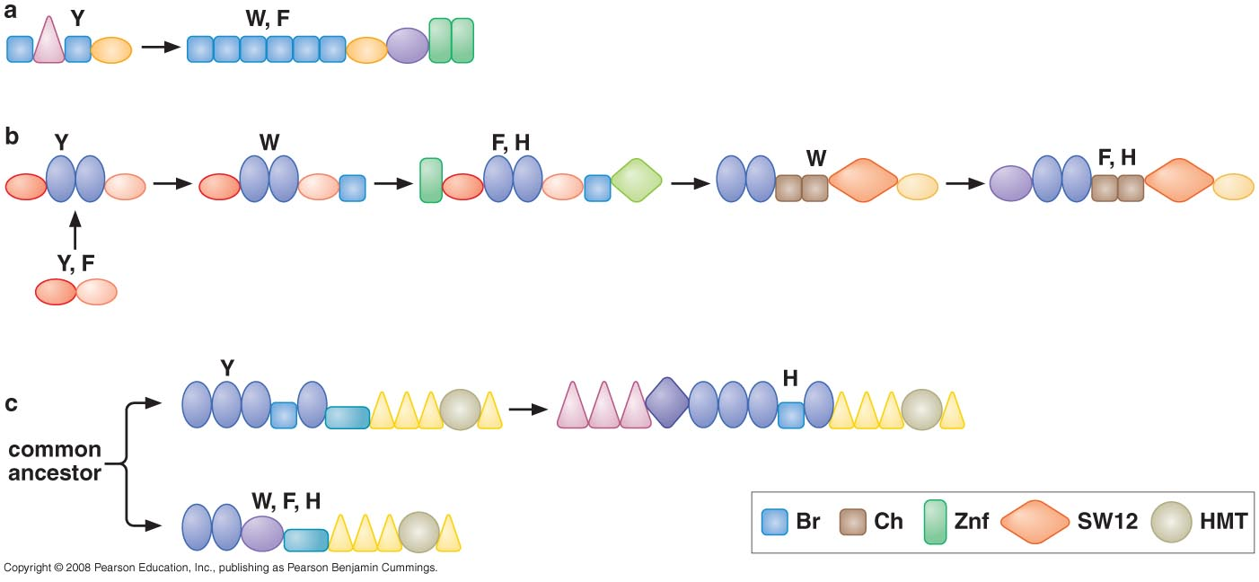
Exon shuffling & protein domain

Slide 58
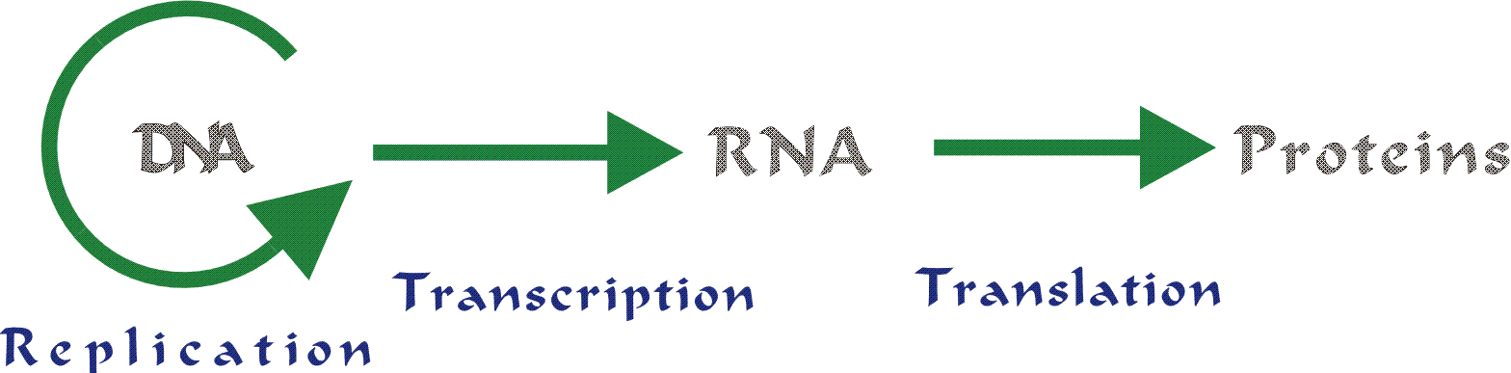
The central dogma is shaken with recent findings!
  Mature mRNA differs from pre-mRNA by
    Splicing
    Editing
  This might be so extensive

Slide 59
RNA editing
First discovered in trypanosomes in 1988
Now it is recognized in different species including humans

Slide 60
I- RNA editing in trypanosomes
Noticed absence of TAC (AUG) initiating codons and other conserved DNA sequences
Could isolate RNA coding for these proteins which are missing in the DNA
Noticed U insertions which corrected the internal frame shifts and created AUG initiation and stop codons (UAA,UAG,UGA)
Editing occurs from 3` to 5` direction

Slide 61
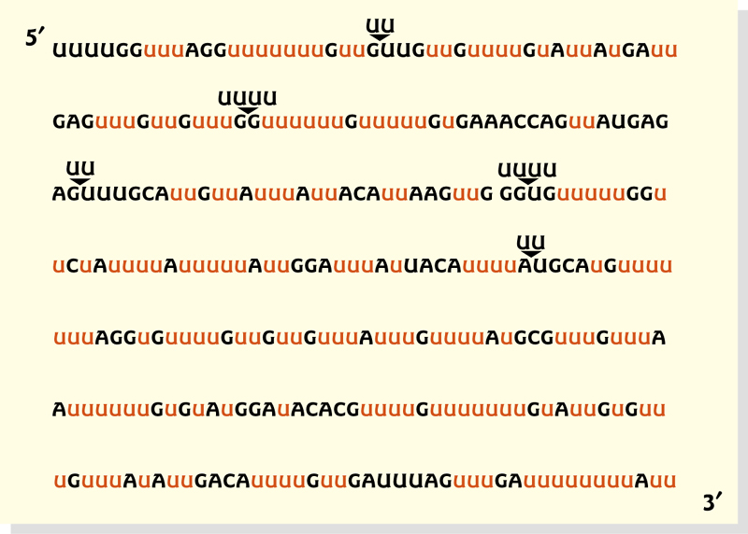
Half of sequence information in mRNA was not present in DNA!

Slide 62
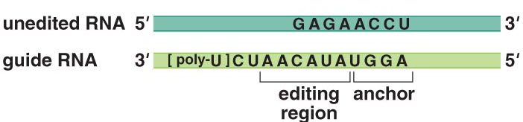
Guide RNA
40-80 nt RNA that specify edited sequences
gRNA is divided into:
  Anchor
  Editing region
  Poly-U stretch
One gRNA can insert several U, and many gRNAs can edit one mRNA
Notes:
Anchor region: at the 5` region and include the complementary sequence of the specific site in the DNA where editing should occur
When mismatching occurs this is the beginning of editing region and it states where exactly U should be inserted
The function poly U stretch is not yet identified

Slide 63
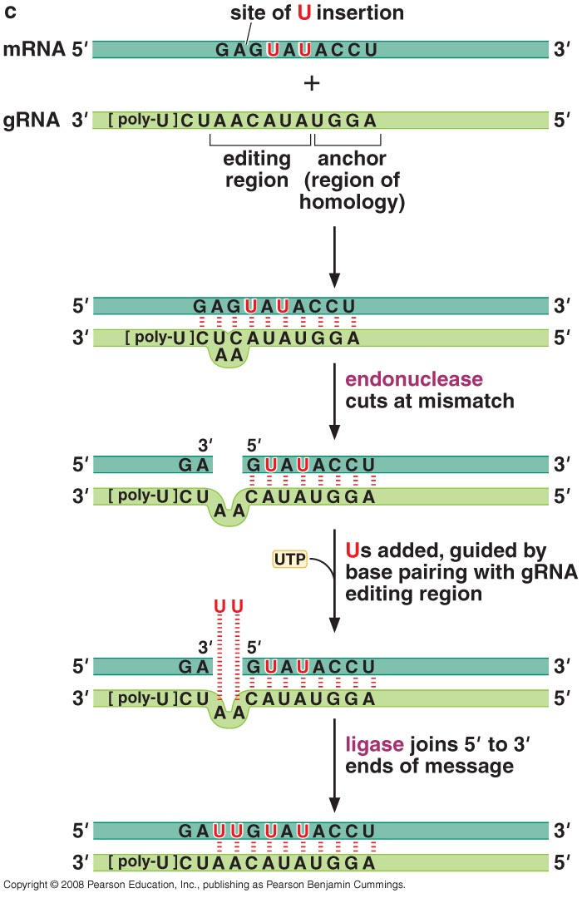
Mechanism of editing
Enzymes needed:
Endonuclease
3`terminal uridylyl transferase TUTase
Ligase

Slide 64
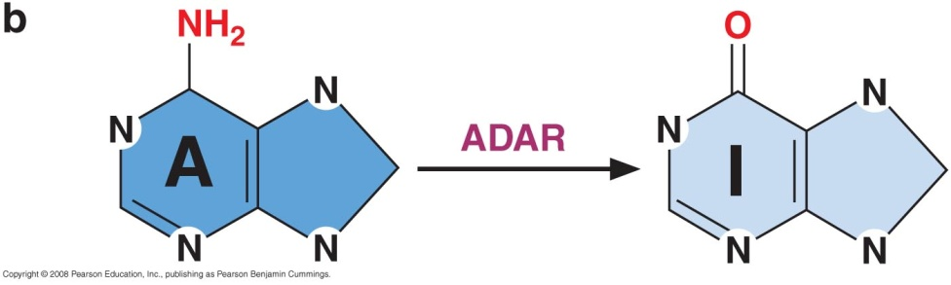
II-RNA editing in mammals (deamination)
1- Adenosine to inosine (A→I) editing
very common
Occurs in introns and untranslated regions →
  Affect splicing
  RNA localization
  RNA stability
I pair with C →
  affect protein sequence
Ion channel in brain is targeted by this editing
  Failure of editing cause impairment of brain development
  Epilepsy, depression and brain tumors

Slide 65
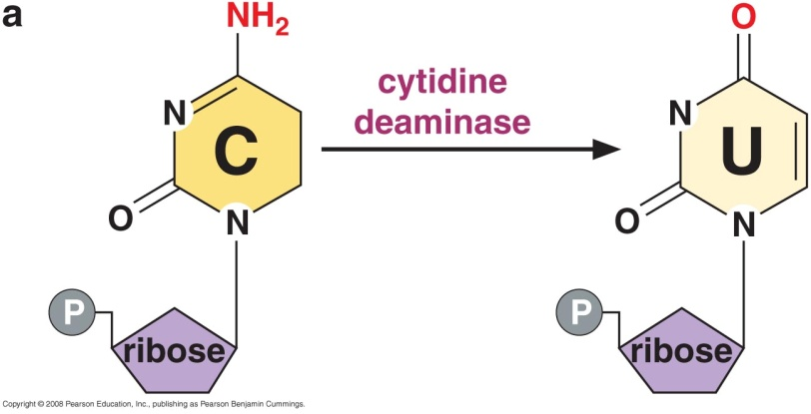
II-RNA editing in mammals (deamination)
2- Cytidine to uridine (C→U) editing
Occurs at two sites
  Apolipoprotein B gene
  Neurofibromatosis type 1
  (NF1) transcript
Which C to target can be controlled by:
  Protein-protein interaction
  Cytindine deaminase has RNA binding site recognize specific sequence
  Protein recognize particular RNA structure
Notes:
Nurofibromatosis type 1 is inherited dominantly and it causes development of fibromas in the peripheral nervous system and other clinical presentations (café au lait) and the NF1 gene product is fibromin and it is important in cellular signaling and is a suppressor for ras oncogene. When mutated C converted to U a premature stop codon and then no functional protein so cancer develops

Slide 66
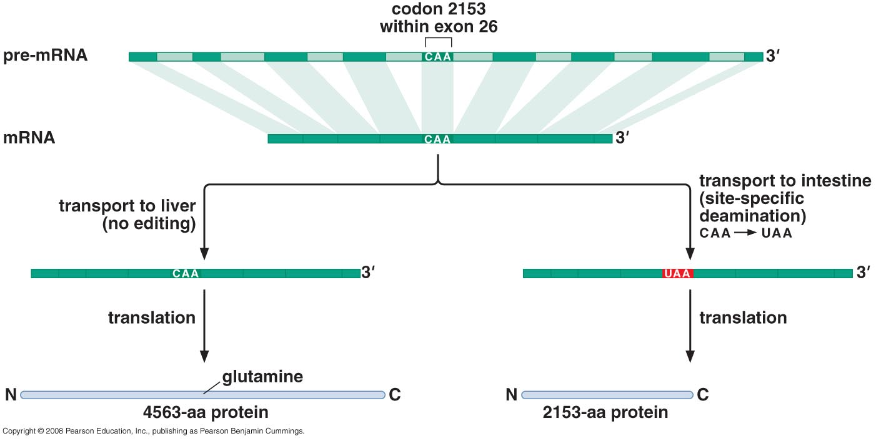
RNA editing in Apolipoprotein B gene
synthesize cholesterol & triglyceride transport of dietary lipids
Notes:
Liver form protein is responsible for transport of endogenously synthesized cholesterol and triglyceride
Intestinal involved in transport of dietary lipids to various tissues
375 CAA triplet in apoB gene of which 100 in glutamine codons, and only this particular CAA is targeted for modification

Slide 67

mRNA transport
Transport from nucleus to cytoplasm is regulated
Only fully processed, capped, polyadenylated mRNA + particular protein signature/code is transported
Export via nuclear pore complex
Energy by GTP hydrolysis
Notes:
Proteins includes SR proteins and other additional proteins

